Slide 1
Slide Updates
Jonathan Kim, Kyler Norton, AJ Geckle

Slide 2
4/29 - 5/5

Slide 3
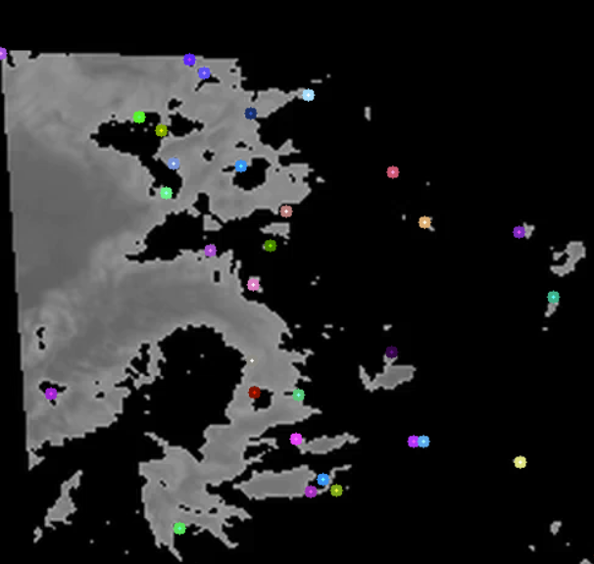
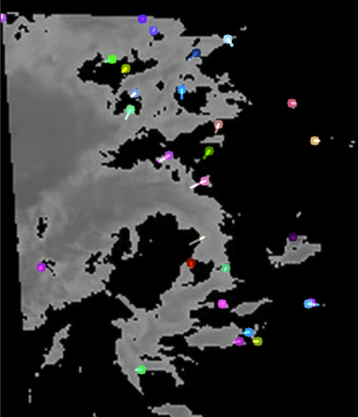
Looking at Optical Flow

Slide 4
Problems with Optical Flow
Motion in image processing defined in three ways:
Changes in light
Changes in an object
Changes in the camera
In clouds there is changes in light and the shape of the clouds
The images are also 15 minutes apart, meaning the shape can vary a lot
When using Optical Flow for objects, expect the object to follow a predictable trend
i.e. yellow or white lines on the road
Seems clouds vary too much for this
Slides from a University of Washington graduate course said Optical Flow not used for cloud motion

Slide 5
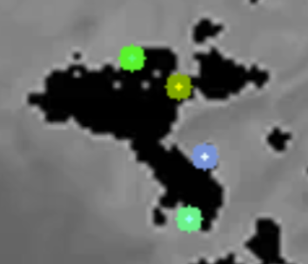
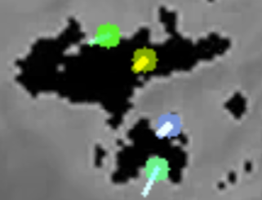
Example of Issue
Here is an example using two images 15 minutes apart
Suppose that Optical Flow worked
What would we want it to look like?
Since the images are so far apart in time, it does not look like “movement” but rather change in shape

Slide 6
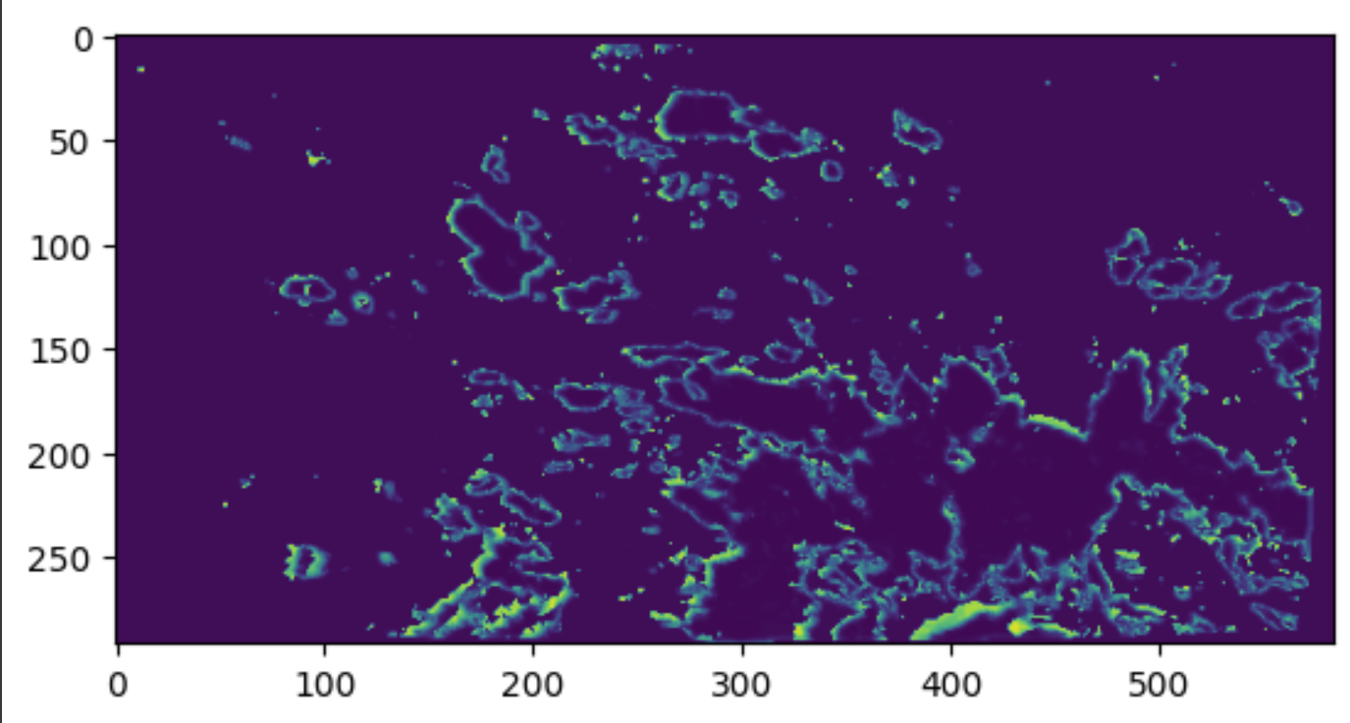
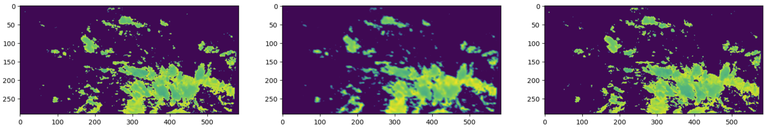
Convolutional Model #1
Trained on images 15 minutes apart
(Predicted - Expected)²
Input Image
Prediction
Expected

Slide 7
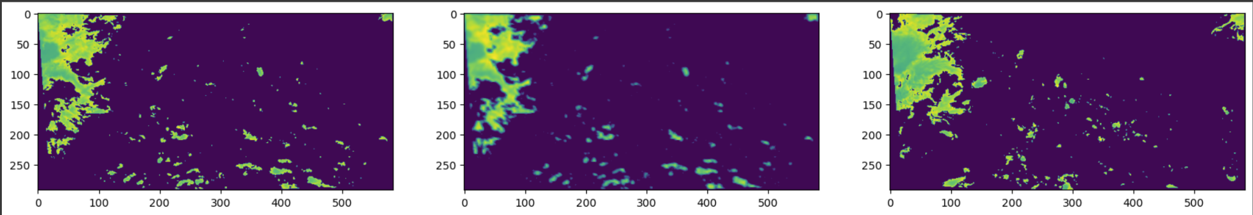
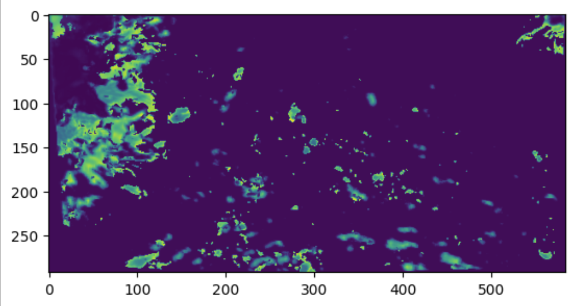
10 Predictions into the future

Slide 8
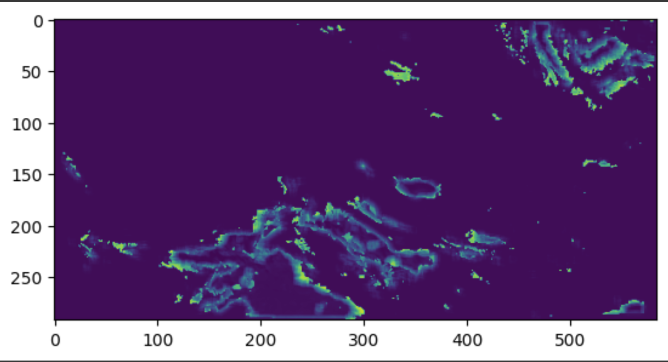
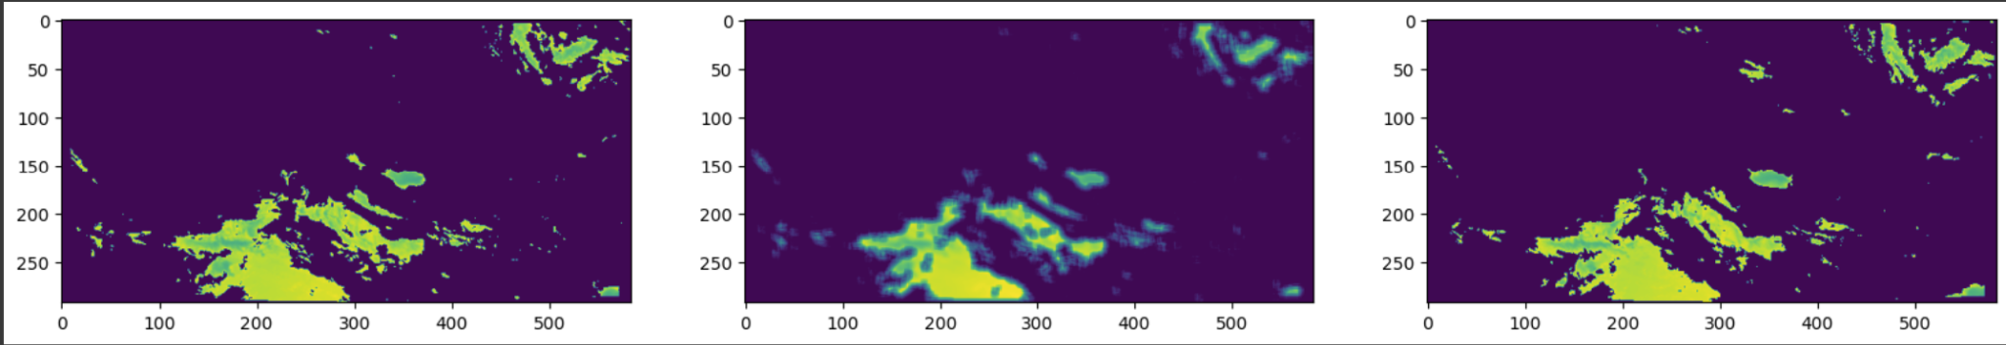
Convolutional Model 2
Trained on images 60 minutes apart
(Predicted - Expected)²
Input Image
Prediction
Expected

Slide 9
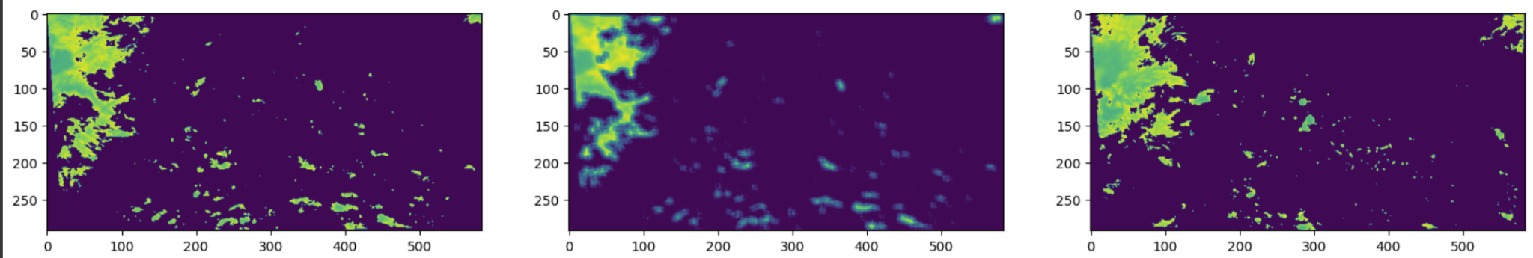
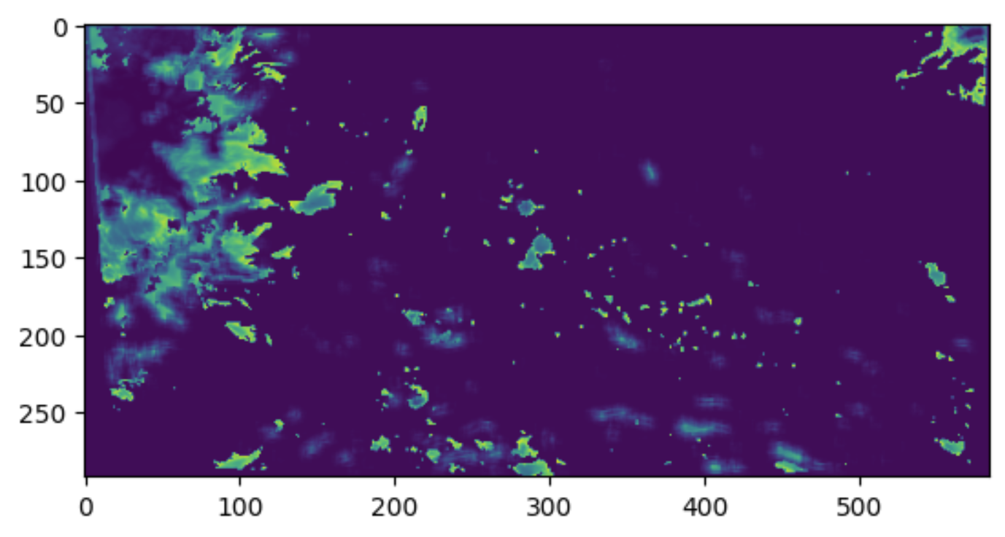
10 Predictions into the future

Slide 10
Convolutional Models
Able to produce images well
Blurring effect most likely due to using MSE optimizer
Ran with binary cross entropy once and was much clearer
Unable to make consecutive predictions

Slide 11
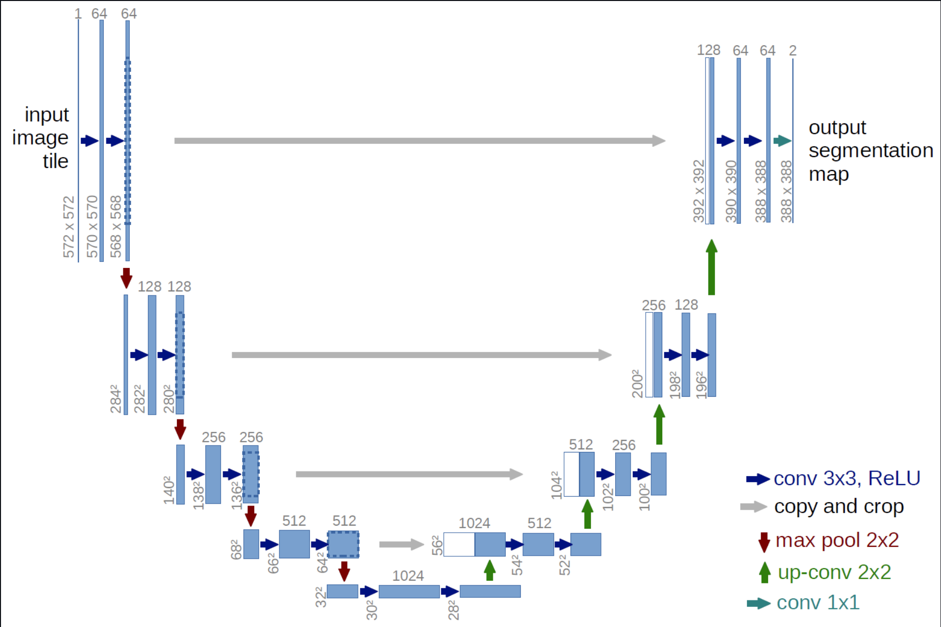
Frame Interpolation
Receive two images as inputs and output a predicted image halfway between them.
U-Net architecture derived from:
Deep Motion: A Convolutional Neural Network for Frame Interpolation Neil Joshi, Duncan Woodbury (2017)

Slide 12
4/8 - 4/14

Slide 13
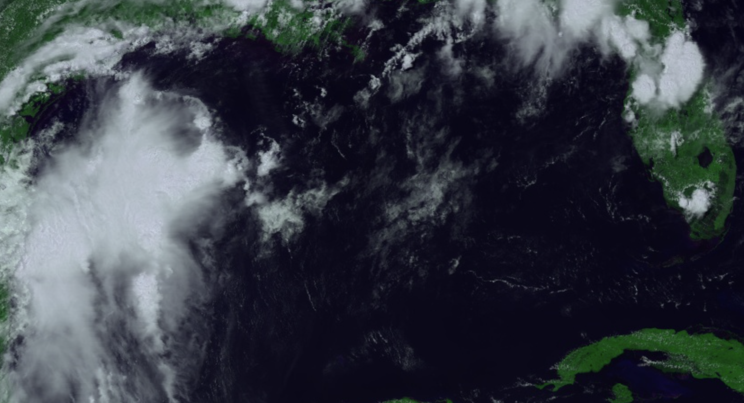

Exporting Images
With applyScaleAndOffset
We have made an algorithm which iterates through the database and applies the band selection determined last week. Unfortunately, at the moment we have not been successful in exporting the imagery with our normal process. We can export images that have not undergone the applyScaleAndOffset function but they are useless for our purposes.
Without applyScaleAndOffset (didn’t forget to insert image)

Slide 14
4/1 - 4/7

Slide 15
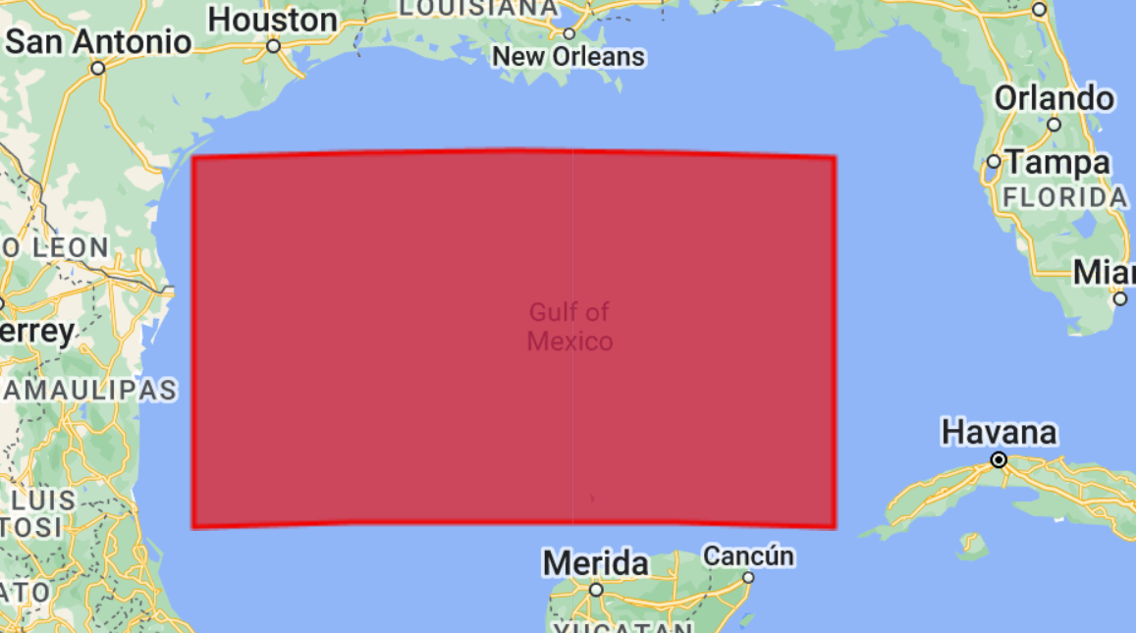
Refined Area of Interest
We refined our area of interest to this particular region of the gulf of mexico. This area should make background subtraction simpler and in the event we reach our goal of hurricane prediction, there will be data available in this region.

Slide 16
GOES Band Selection
Many combinations of bands were tested in an attempt to find the best cloud focusing result.
The best images were produced by the following combinations:
Red visual band and the IR Cloudtop phase band
Near IR Cirrus cloud band + IR CO2 band + IR Cloudtop phase band

Slide 17
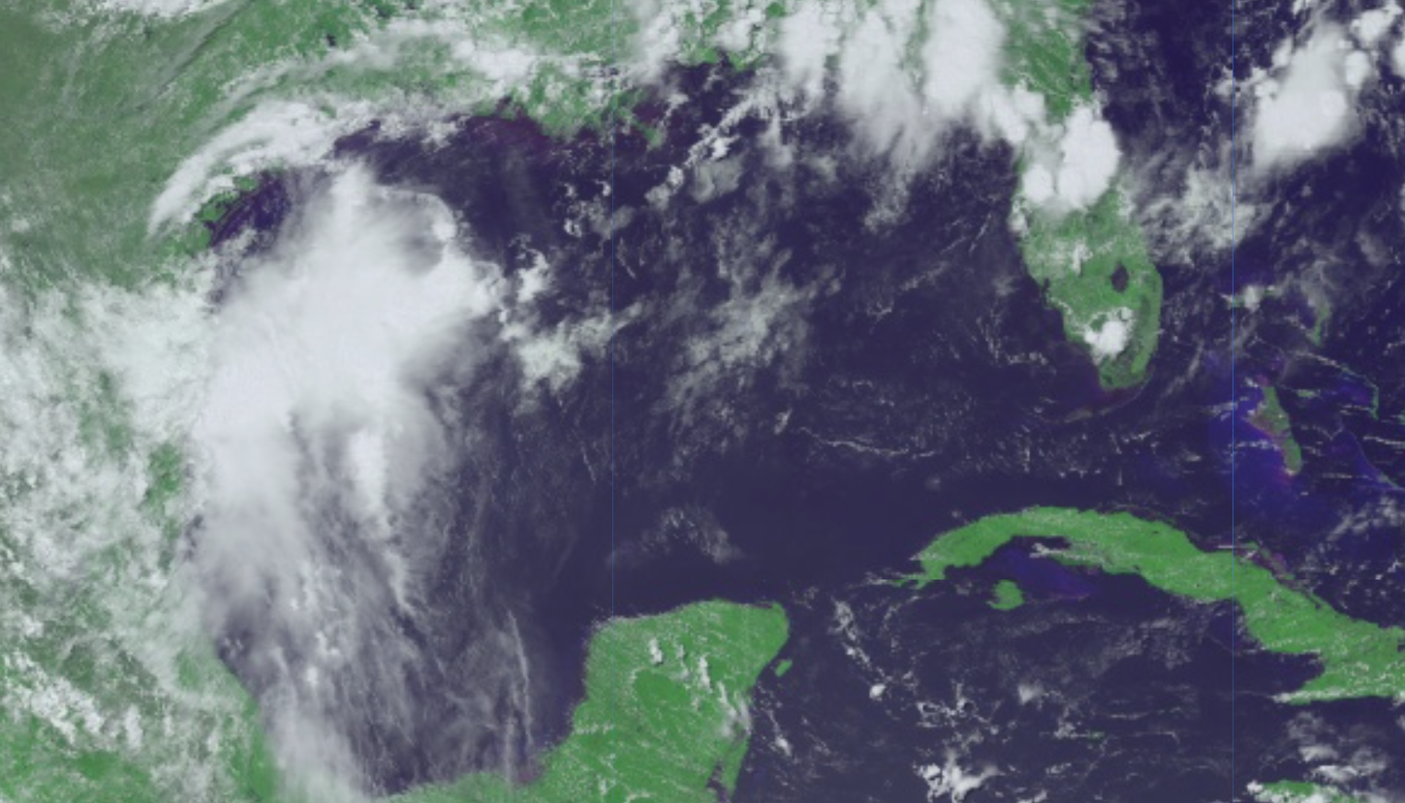
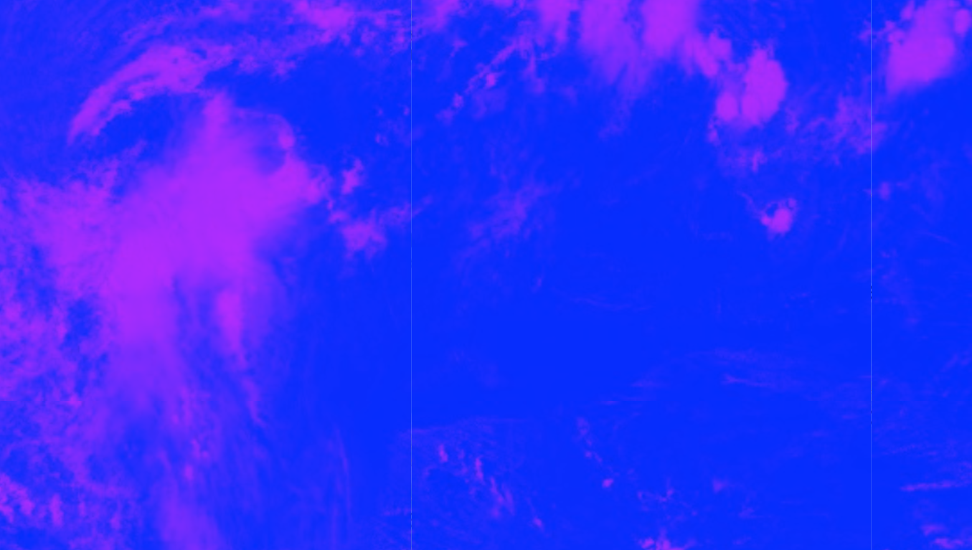
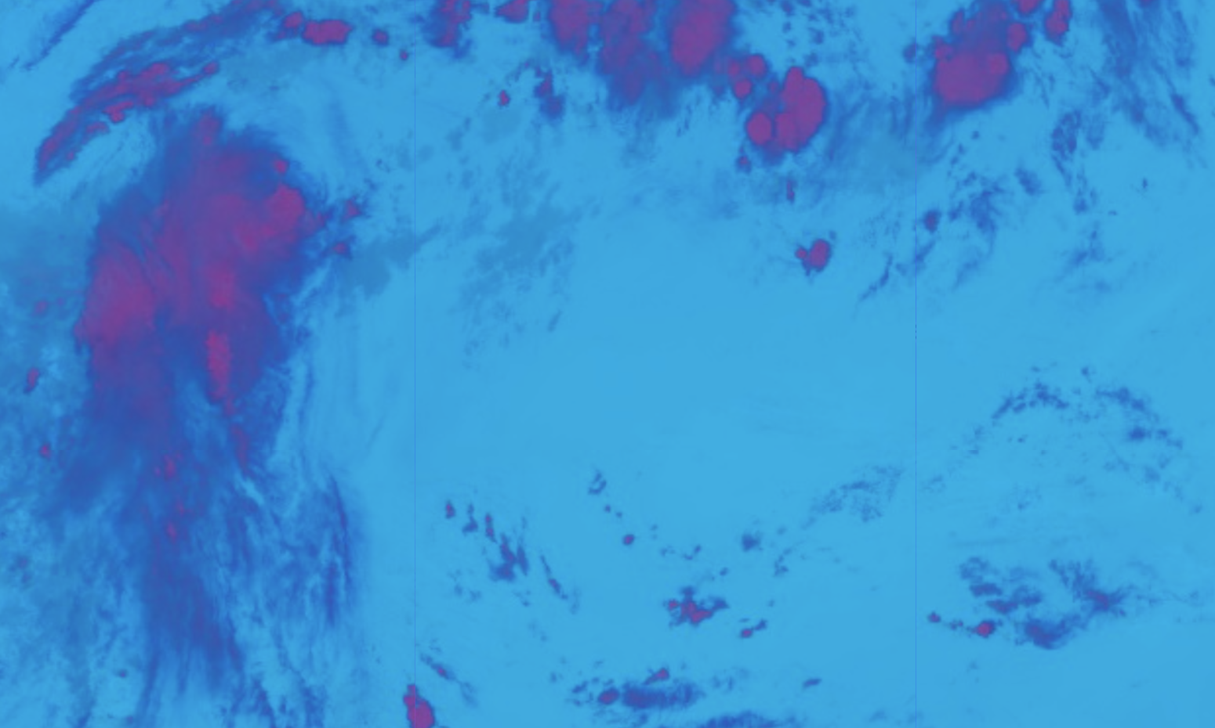
a) RGB visual of AOI
b) Red + Cloud-top Phase bands
c) Cirrus + CO2 + Cloud-Top Phase bands

Slide 18
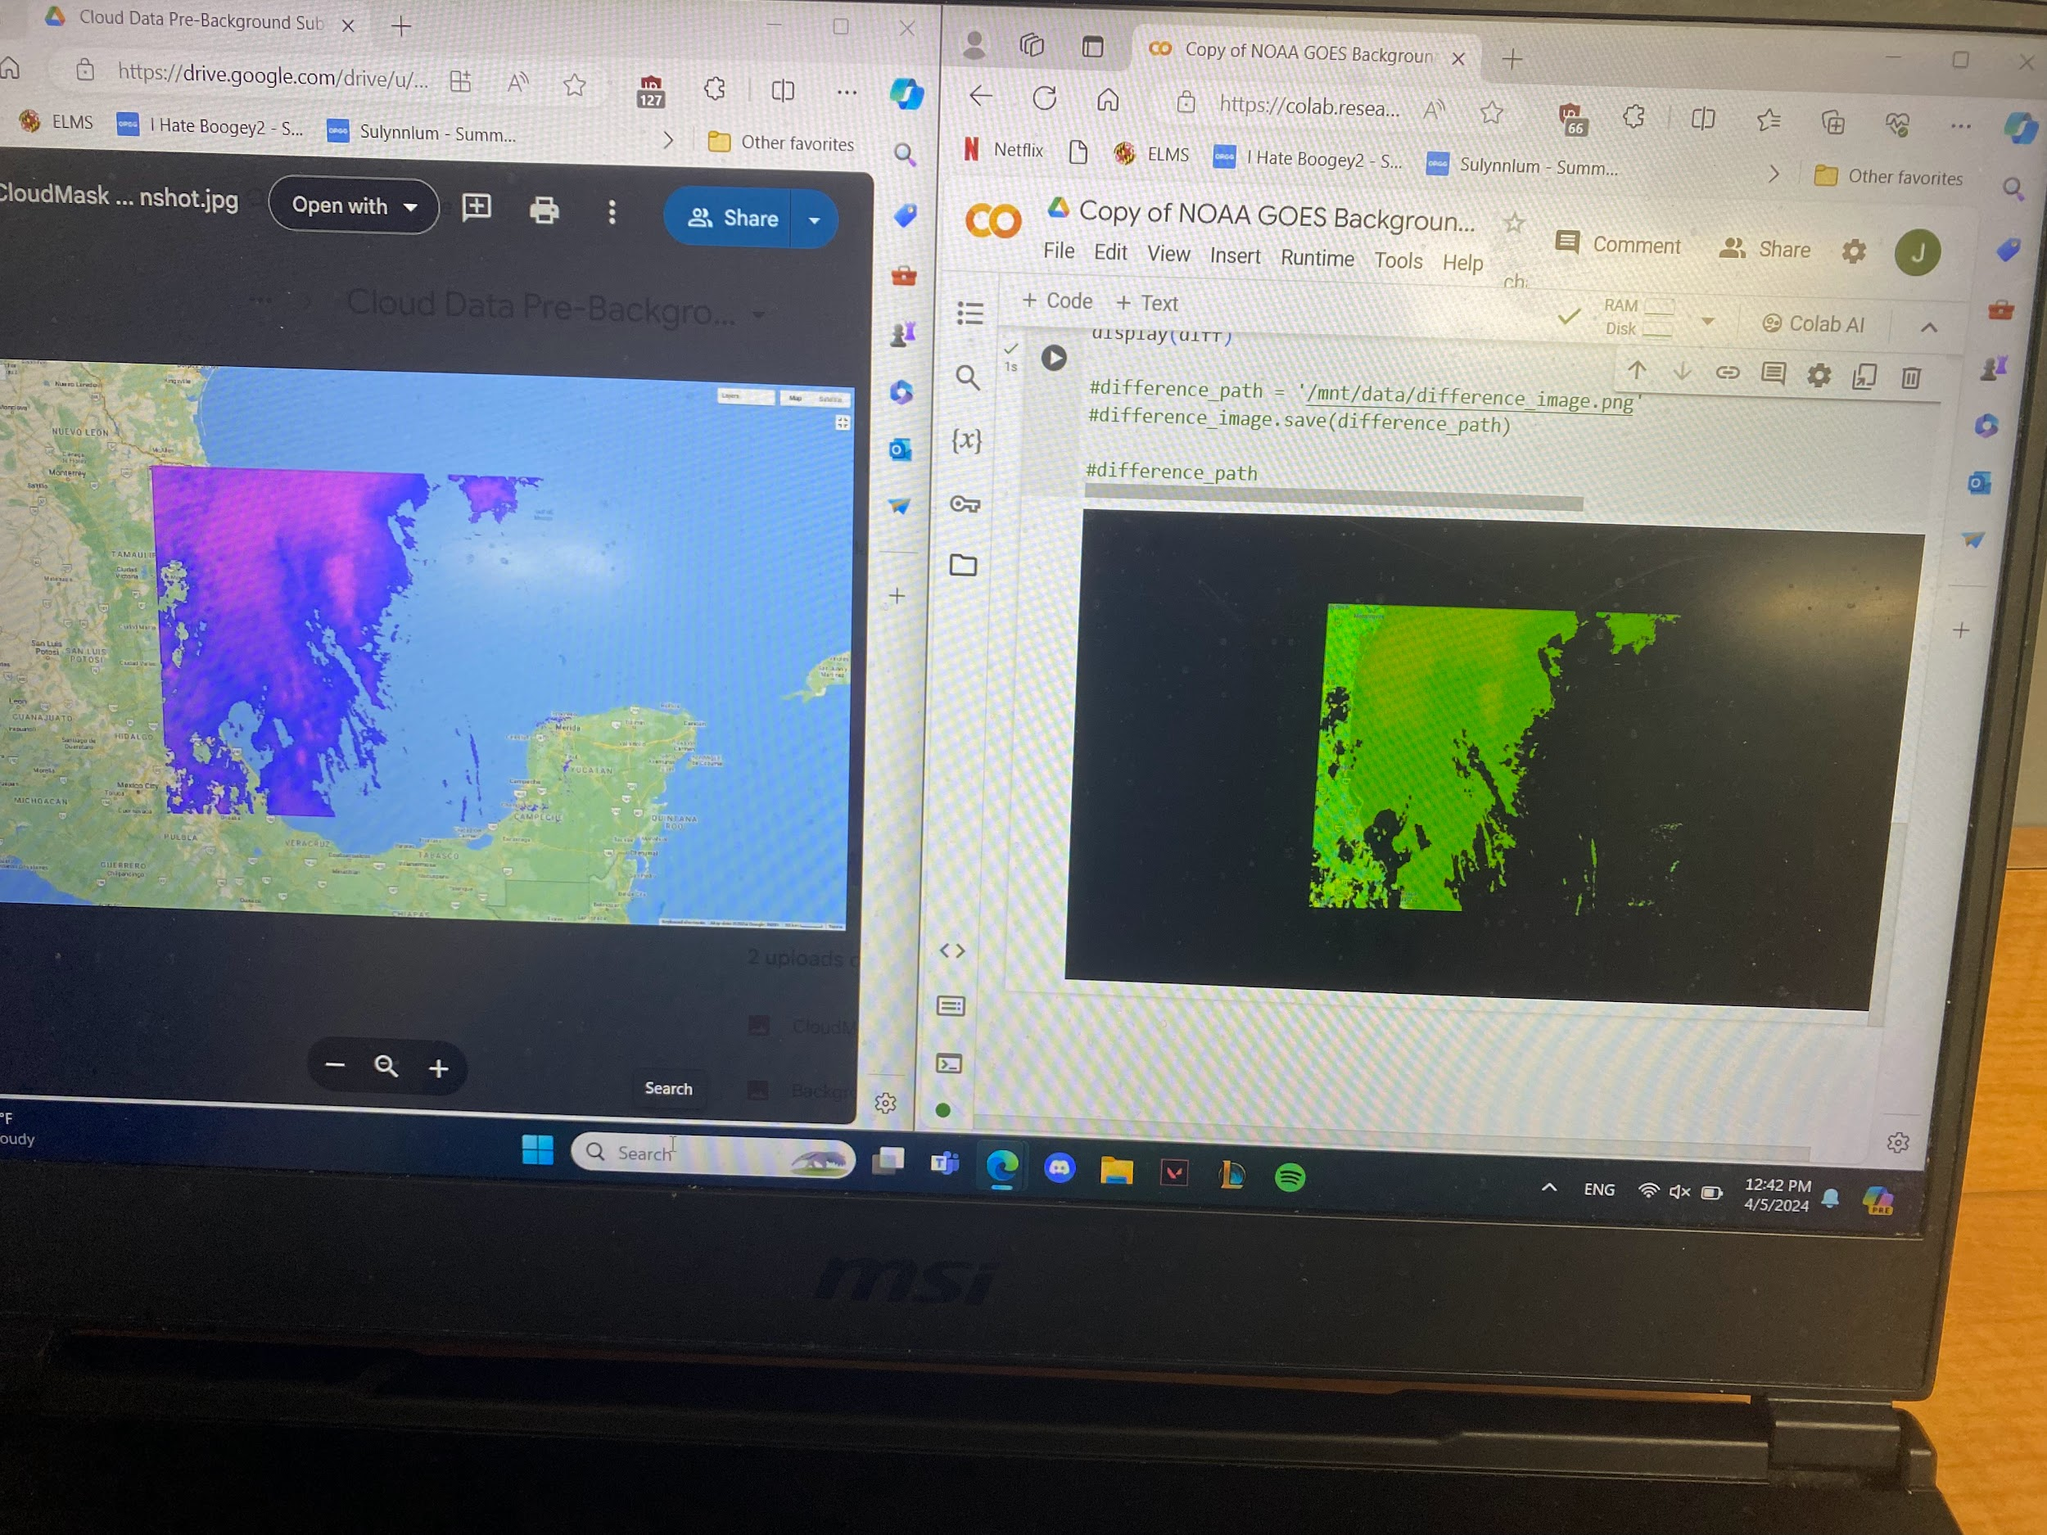
Background Subtraction
Developed a method to subtract the google maps background from our area of interest, leaving only the clouds.

Slide 19
Image Capturing Process
Our current method of acquiring training imagery is less than ideal. It involves applying the band functionality to individual GOES images and then taking a screenshot of the result. This is because the Earth Engine API does not allow the exporting of their data in image formats.

